Slide 1
Regression Analysis
Analysis of Variance
Nicoleta Serban, Ph.D.
Professor
School of Industrial and Systems Engineering
Hypothesis Test for Equal Means

Slide 2

About This Lesson

Slide 3
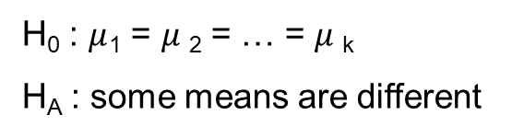
Hypothesis Test for Equal Means
H₀ : $μ$₁ = $μ$₂ = … = $μ$_{k}
H_{A} : some means are different

Slide 4
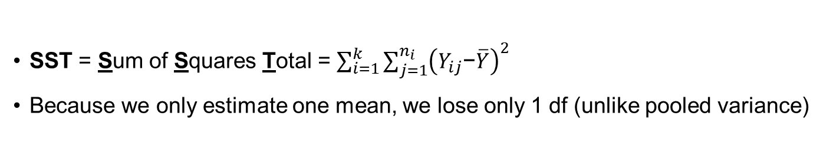
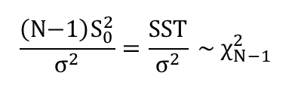
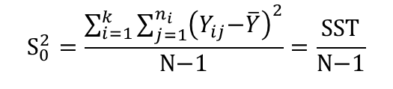
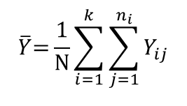
Null Hypothesis
Under the null hypothesis, combine k samples to estimate the overall mean with the overall sample mean (grand mean) $\overline{Y}$:
$$\overline{Y}\text{=}\frac{\text{1}}{\text{N}}\sum_{i=1}^{k}{\sum_{j=1}^{n_{i}}{Y_{ij}}}$$
Base the null hypothesis variance estimate ${\text{S}}_{0}^{2}$on this overall sample mean:
$${\text{S}}_{0}^{2}=\frac{\sum_{i=1}^{k}{\sum_{j=1}^{n_{i}}{{\left(Y_{ij}\text{−}\overline{Y}\right)}^{2}}}}{\text{N}\text{−1}}=\frac{\text{SST}}{\text{N}\text{−1}}$$
SST = Sum of Squares Total = $\sum_{i=1}^{k}{\sum_{j=1}^{n_{i}}{{\left(Y_{ij}\text{−}\overline{Y}\right)}^{2}}}$
Because we only estimate one mean, we lose only 1 df (unlike pooled variance)
$$\frac{\left(\text{N}\text{−1}\right){\text{S}}_{0}^{2}}{{\text{σ}}^{2}}=\frac{\text{SST}}{{\text{σ}}^{2}} \text{\sim } {\text{χ}}_{N−1}^{2}$$

Slide 5
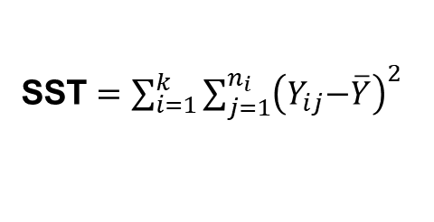
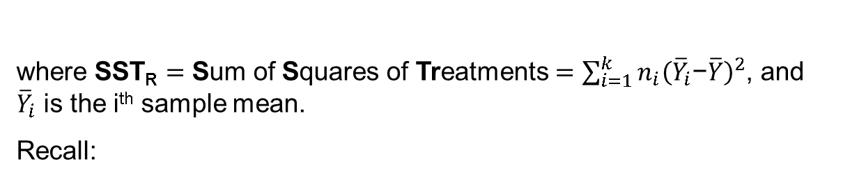
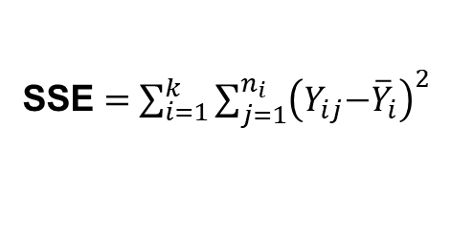
SST Decomposition
We can partition SST into two separate parts:
SST = SSE + SST_{R}
where SST_{R} $=$ Sum of Squares of Treatments $=\sum_{i=1}^{k}{n_{i}{\left({\overline{Y}}_{i}\text{−}\overline{Y}\right)}^{2}}$, and
${\overline{Y}}_{i}$ is the i^{th} sample mean.
Recall:
SST = $\sum_{i=1}^{k}{\sum_{j=1}^{n_{i}}{{\left(Y_{ij}\text{−}\overline{Y}\right)}^{2}}}$
SSE = $\sum_{i=1}^{k}{\sum_{j=1}^{n_{i}}{{\left(Y_{ij}\text{−}{\overline{Y}}_{i}\right)}^{2}}}$
MSE = SSE/(N-k) = within-group variability
MSST_{R} = SST_{R} /(k-1) = between-group variability
ANOVA: comparing between to within variability
F = between-group variability / within-group variability

Slide 6

Testing Equal Variances with F-Test
$$\frac{{SSTR}/{\left(k−1\right)}}{{SSE}/{\left(N−k\right)}}\text{≡}\frac{MSTR}{MSE}\text{=} {\text{F}}_{0} \text{\sim } {\text{F}}_{k−1, N−k}$$
if H_{o} is true
Reject H_{o} if F₀ > F_{a}(k-1,N-k), which is the upper α^{th} quantile of the F distribution.
P-value for the F-test = P( F > F₀), where F ~ F_{(k-1,N-k)}

Slide 7
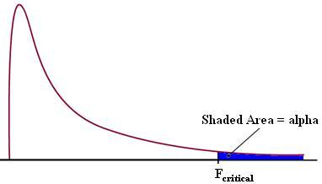
Testing Equal Variances with F-Test
$$\frac{{SSTR}/{\left(k−1\right)}}{{SSE}/{\left(N−k\right)}}\text{≡}\frac{MSTR}{MSE}\text{=} {\text{F}}_{0} \text{\sim } {\text{F}}_{k−1, N−k}$$
if H_{o} is true
Reject H_{o} if F₀ > F_{a}(k-1,N-k), which is the upper α^{th} quantile of the F distribution.
P-value for the F-test = P( F > F₀), where F ~ F_{(k-1,N-k)}

Slide 8

Example 1: Global Suicide by Region
Are the mean suicide rates equal across the different country regions?

Slide 9
Testing for Equal Means
summary(aov(suicidesper100k ~ region, data=suicide_data))
Df Sum Sq Mean Sq F value Pr(>F)
region 9 1548 172.06 4.767 4.71e-05 ***
Residuals 77 2779 36.09
---
Signif. codes: 0 ‘***’ 0.001 ‘**’ 0.01 ‘*’ 0.05 ‘.’ 0.1 ‘ ’ 1
SST_{R} = 1548
k-1 = 9
SSE = 2779
N-k = 77
F-value = 4.767
P-value = 4.71e-05
P-value ≈ 0:
Reject the null hypothesis of equal mean heights

Slide 10

Example 2: Keyboard Layout
Three different keyboard layouts are being compared in terms of typing speed.
Layout 1 Layout 2 Layout 3
23.8 30.2 27.0
25.6 29.9 25.4
24.0 29.1 25.6
25.1 28.8 24.2
25.5 29.1 24.8
26.1 28.6 24.0
23.8 28.3 25.5
25.7 28.7 23.9
24.3 27.9 22.6
26.0 30.5 26.0
24.6 * 23.4
27.0 * *
Are the mean typing times for the three keyboard layouts statistically different?

Slide 11
Testing for Equal Means
summary(aov(speed ~ layout))
Df Sum Sq Mean Sq F value Pr(>F)
layout 2 121.24 60.62 52.84 1.48e-10 ***
Residuals 30 34.42 1.15
---
Signif. codes: 0 ‘***’ 0.001 ‘**’ 0.01 ‘*’ 0.05 ‘.’ 0.1 ‘ ’ 1
SSTR = 121.24
k-1 = 2
SSE = 34.42
N-k = 30
F-value = 52.84
P-value = 1.48e-10
P-value ≈ 0:
Reject the null hypothesis of equal mean typing times

Slide 12

Summary

